Slide 1
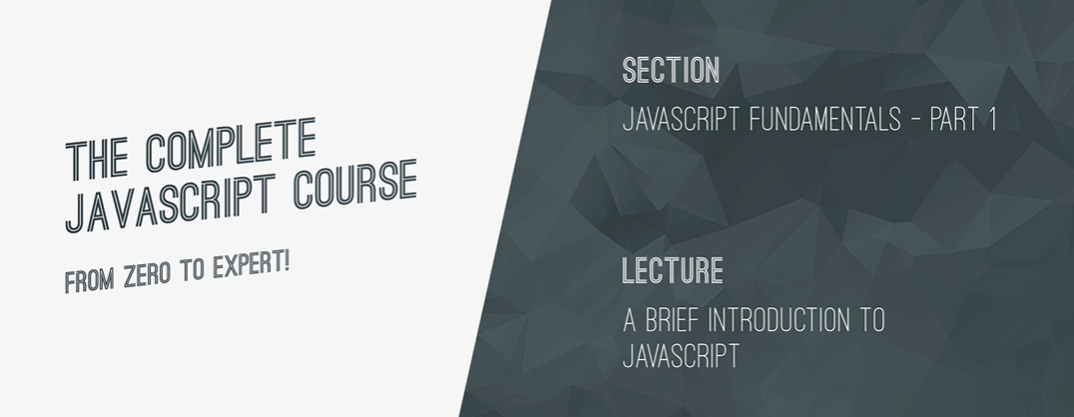

Slide 2
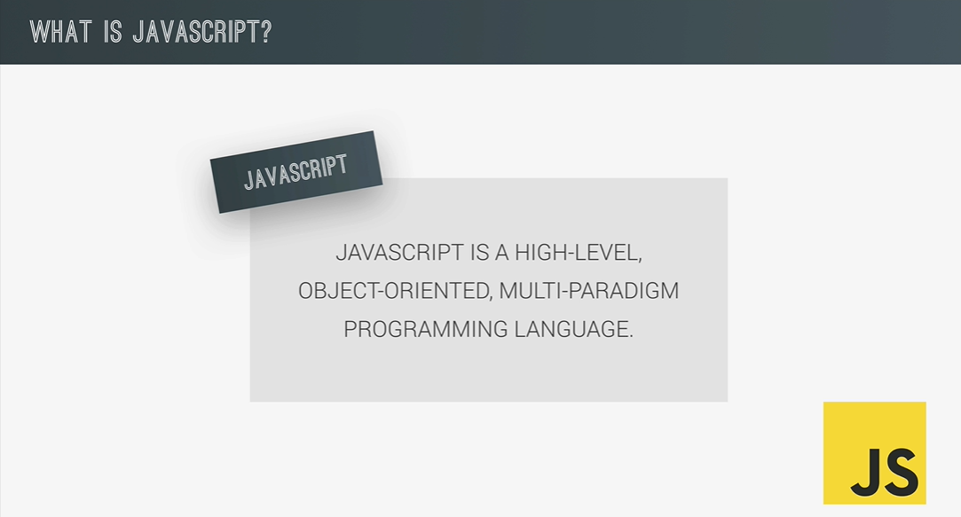

Slide 3
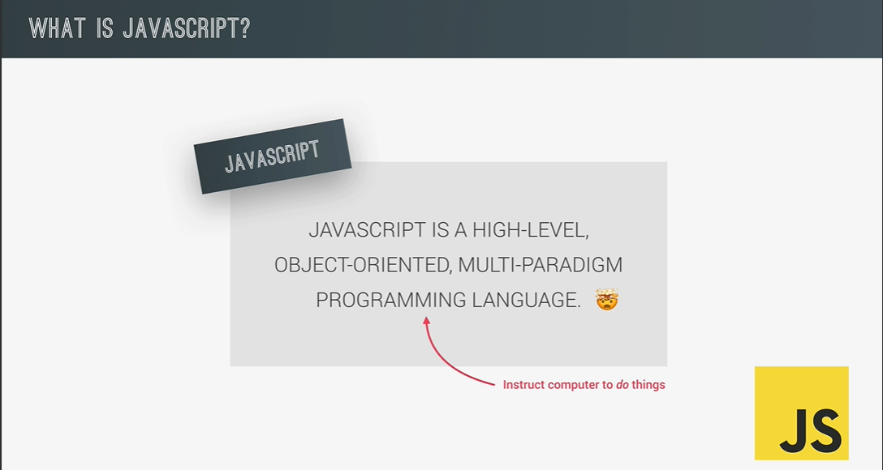

Slide 4


Slide 5
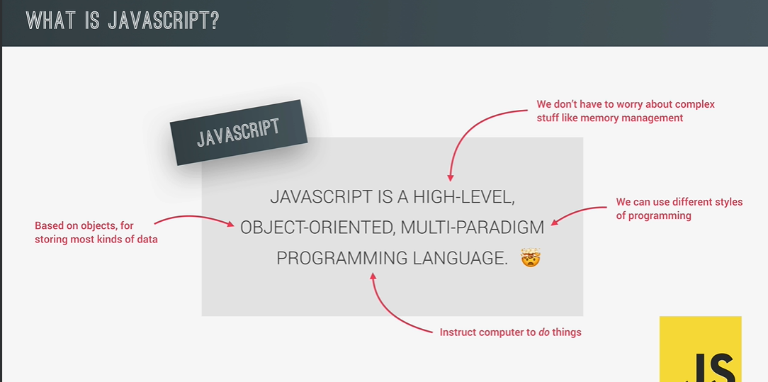

Slide 6
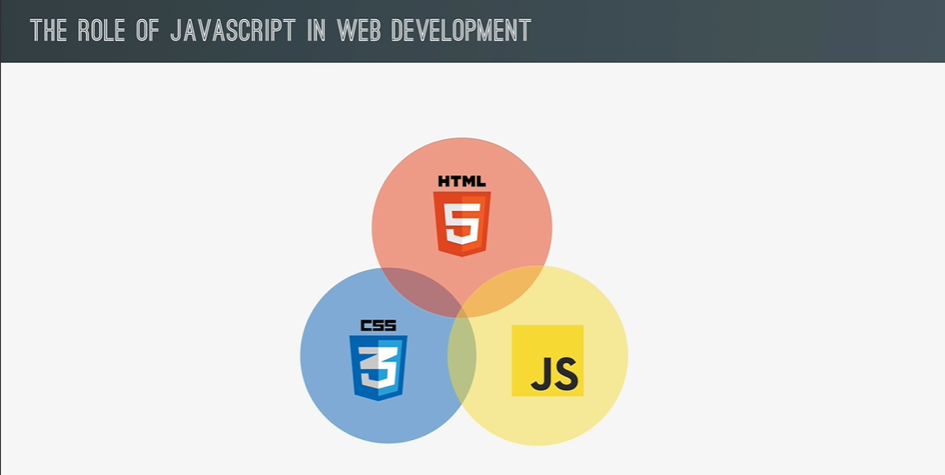

Slide 7
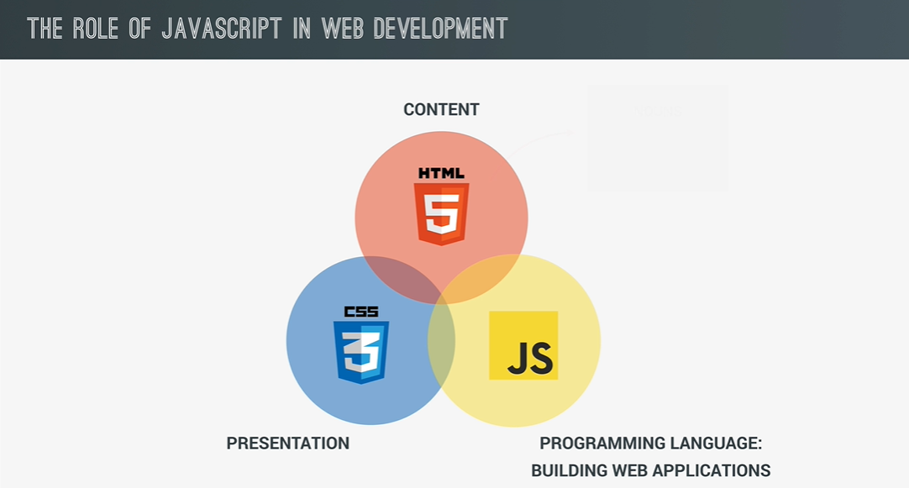

Slide 8
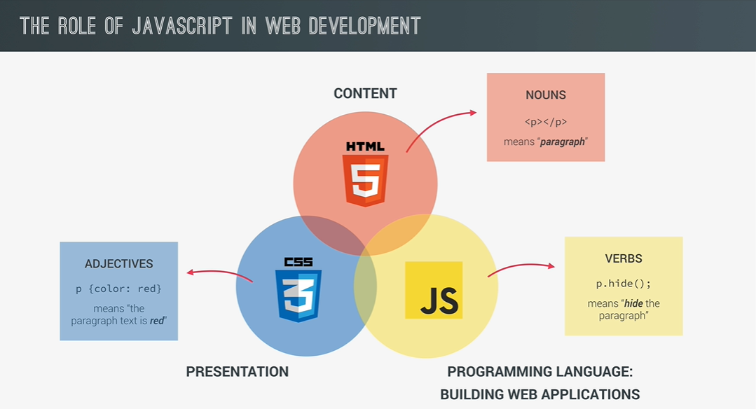

Slide 9
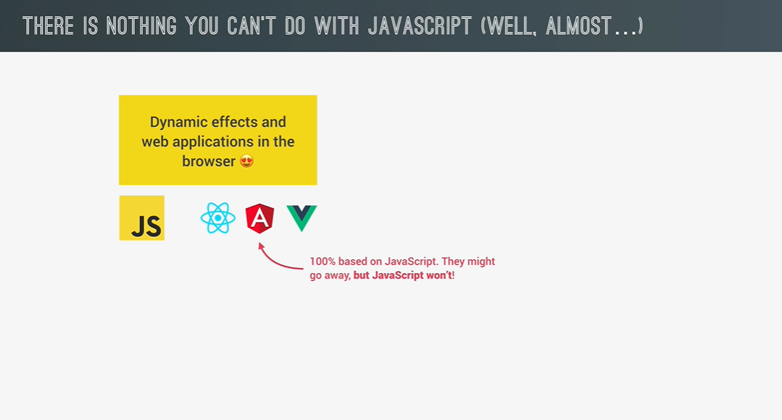

Slide 10
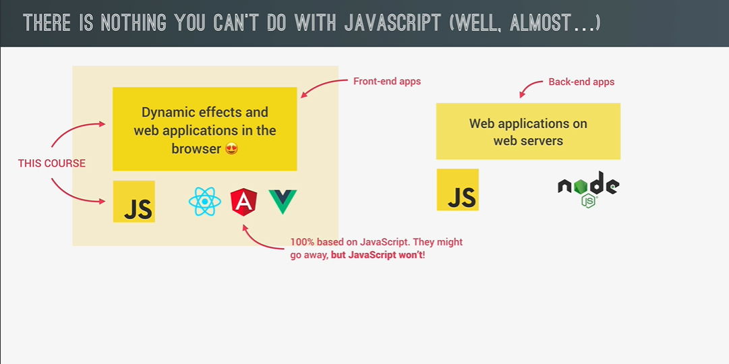

Slide 11
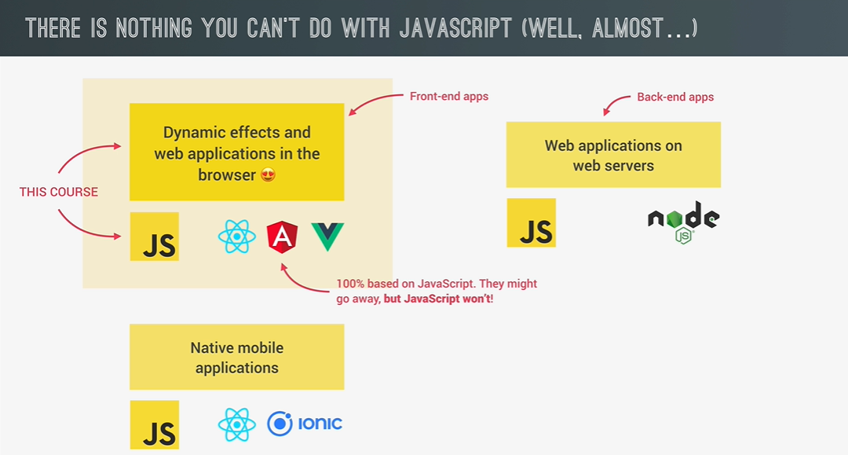

Slide 12
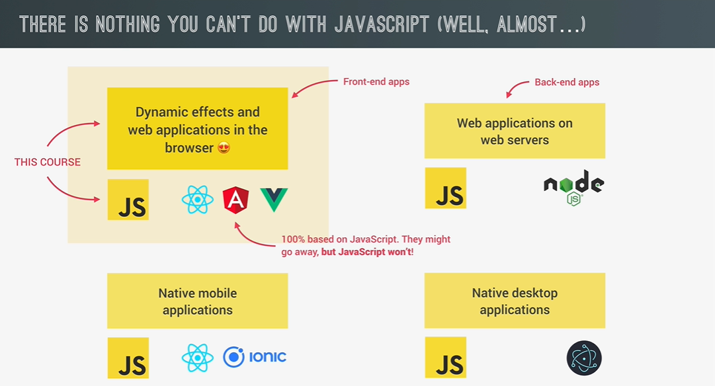

Slide 13
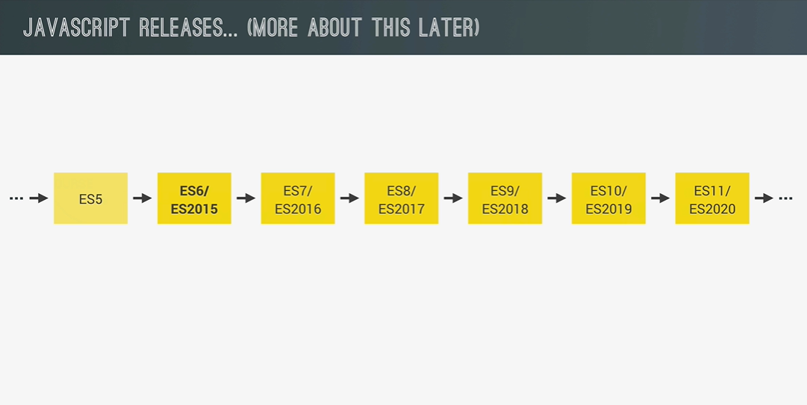

Slide 14
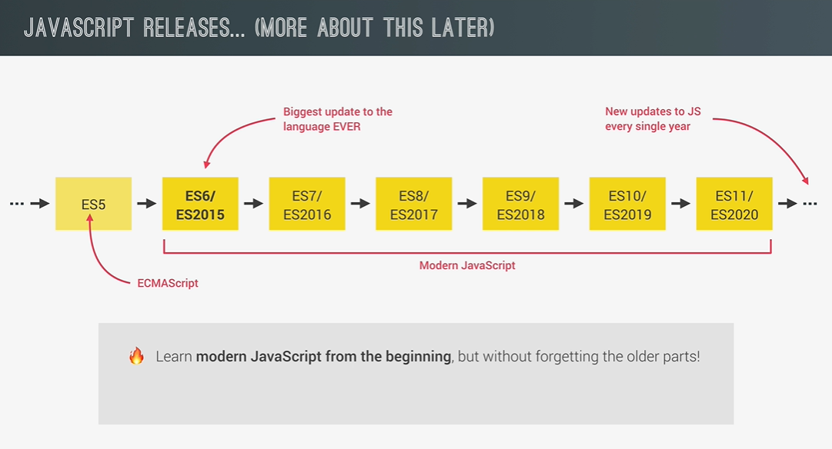

Slide 15
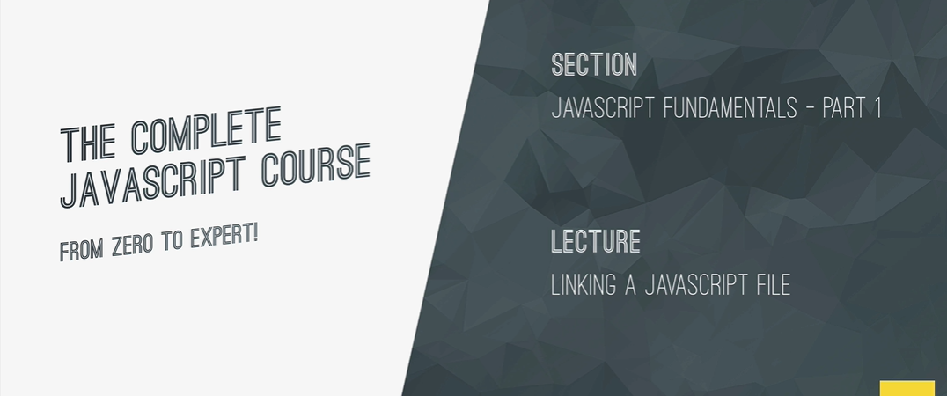

Slide 16
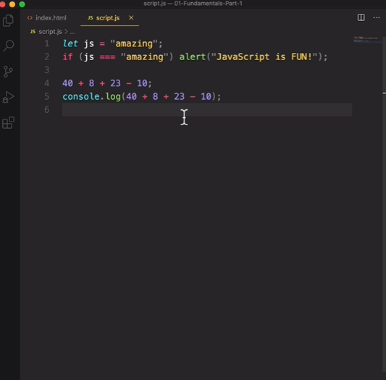

Slide 17
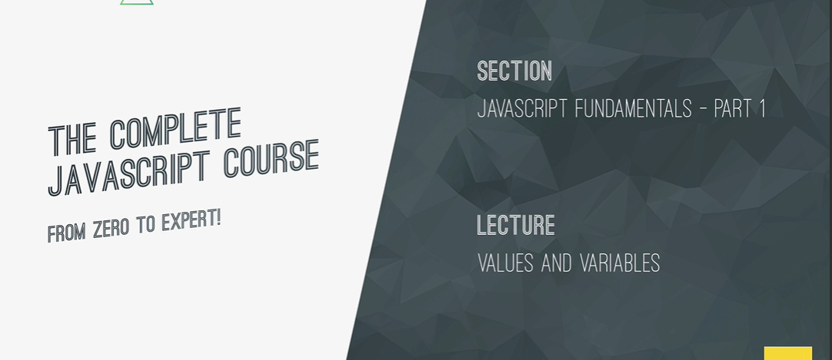

Slide 18
Values:
It is basically a piece of data.
For example
‘Jonas’

Slide 19
Variables are Containers for Storing Data
JavaScript Variables can be declared in 4 ways:
Automatically
Using var
Using let
Using const

Slide 20
var Keyword
The var keyword is used to declare a variable. It has a function-scoped or globally-scoped behavior.
var x = 10;
Example: In this example, we will declare variables using var.

Slide 21
let Keyword
The let keyword is a block-scoped variables. It’s commonly used for variables that may change their value.
let y = "Hello";
Example: In this example, we will declare variables using let.

Slide 22
const Keyword
The const keyword declares variables that cannot be reassigned. It’s block-scoped as well.
const PI = 3.14;
Example: In this example, we will declare the variable using the const keyword.

